Slide 1
Chapter 10: Create an IoT Solution
IOT CƠ BẢN
502068

Slide 2
Ghi chú về bản quyền
Toàn bộ nội dung bài giảng là của CISCO, sinh viên có quyền tải về, lưu trữ, in ấn, tham khảo cho mục đích học tập. Sinh viên không được phát hành lại hay thay đổi nội dung slide nếu chưa có sự đồng ý của chủ sở hữu.
Phần ghi chú ở cuối slide (nếu có) là do các thầy cô ghi chú lại trong quá trình giảng dạy.

Slide 3
Instructor Materials Chapter 6 Create an IoT Solution
IoT Fundamentals
Connecting Things v2.01
Notes:
Cisco Networking Academy Program
Connecting Things
Sensors

Slide 4
Chapter 6 - Sections & Objectives
6.1 Become a Global Problem Solver
Investigate real-world social or environmental problems.
6.2 Design a Solution
Design an IoT solution that addresses a real-world social or environmental problem.
6.3 Build, Test & Document a simple IoT System
Create an IoT system.
6.4 The Business Aspects
Design a plan to market an IoT solution.
6.5 What is Next?
Explain how to continue your learning about the IoT.
Notes:
3

Slide 5
6.1 Become a Global Problem Solver
Notes:
Cisco Networking Academy Program
Connecting Things
Chapter 5: Connecting the Unconnected

Slide 6
Become a Global Problem Solver 6.1.1 Solving Global Problems
Organizations Doing Global Good
Global problems include the burning of fossil fuels, air pollution, oceans becoming more acidic, climate change, poverty, hunger, disease, gender inequality, and access to water and sanitation.
Some companies and organizations provide funds to help these global problems such as the Bill & Melinda Gates Foundation and The Musk Foundation.
The Millennium development Goals
In 2000, leaders from 189 countries made a list of 8 goals to be achieved in 15 years.
These eight goals were called the Millennium Development Goals (MDGs).
United Nations Development Programme (UNDP) is working on fulfilling these goals.
Progress on MDGs so far:
People who live on less than $1.25 per day has dropped by more than half.
Young children going to school is up by almost half.
People receiving HIV treatment increased by over 15 times.
Lowered child mortality rate by almost half.
.
Notes:
6.1– Become a Global Problem Solver
6.1.1 – Solving Global Problems

Slide 7

Become a Global Problem Solver Solving Global Problems (Cont.)
The Sustainable Development Goals
In 2015, 189 world leaders at the United Nations Sustainable Development Summit unanimously adopted the 2030 Agenda for Sustainable Development.
The result was a set of 17 Sustainable Development Goals (SDGs).
These new SDGs go much further than the MDGs.
They are addressing the root causes of poverty and the universal need for development that works for all people.
Notes:
6.1 – Become a Global Problem Solver
6.1.1 – Solving Global Problems (Cont.)

Slide 8
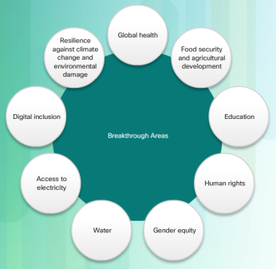
Become a Global Problem Solver 6.1.2 Globally Transformative Breakthrough Technologies
Lawrence Berkeley National Lab
The Lawrence Berkeley National Lab (LBNL).
The Institute of Globally Transformative Technologies (LIGTT) (pronounced ‘light’) is part of LBNL and was created in 2012.
The goal of LIGTT is to leverage LBNL’s resources to develop and deploy breakthrough technologies for sustainable global development.
Institute of Globally Transformative Technologies
The LIGTT released a top "50 Breakthroughs" study in 2014.
Identified some of the most important breakthrough technologies that are required for sustainable global development.
LIGTT aims to develop many of these breakthroughs. Achieving this will make substantial impacts on poverty.
Breakthrough #42 is directly related to using the IoT to enable new services.
Notes:
6.1 – Become a Global Problem Solver
6.1.2 – 50 Globally Transformative Breakthrough Technologies

Slide 9
6.2 Designing a Solution
Notes:
Cisco Networking Academy Program
Connecting Things
Chapter 6: Create an IoT Solution
6.2 – Designing a Solution

Slide 10
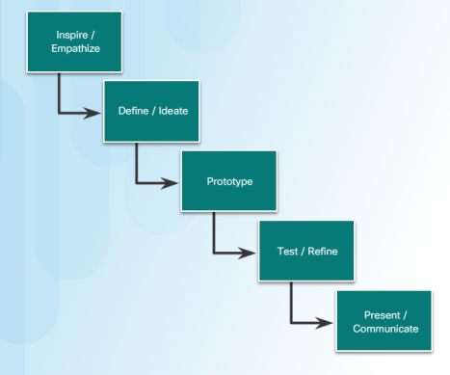
Become a Global Problem Solver 6.2.1 Designing Solutions
The Engineering Design Process
How can we help solve global challenges?
The engineering design process is a proven method.
The five steps are cyclical which means that they can be repeated as many times as needed to make improvements in the design process.
Inspire/Empathize
Define/Ideate
Prototype
Test/Refine
Present/Communicate.
Notes:
6.2 – Become a Global Problem Solver
6.2.1 – Designing Solutions

Slide 11

Become a Global Problem Solver 6.2.1 Designing Solutions (Cont.)
Security Design
Security should be included from the beginning, in the design phase.
Ensure new devices facilitate software updates and all hidden backdoors are removed
On pre-manufactured devices used in projects ensure the following:
Default passwords/usernames are changed.
UPnP is disabled on IoT devices if possible.
Remote device management is protected with strong passwords and access limited to trusted personnel.
Ensure all devices are updated with the latest software updates and patches.
Ensure all devices support and use encryption and certificates.
Secure the physical location of IoT devices as much as possible.
Notes:
6.2 – Become a Global Problem Solver
5.2.1 – Designing Solutions (Cont.)

Slide 12
6.3 Create an IoT System
Notes:
6.3 – Create an IoT Solution

Slide 13

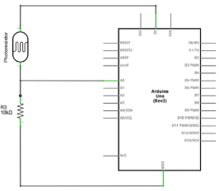
Create an IoT System 6.3.1 THE IoT System Project
Project Overview
Identify a problem that can be solved by an IoT device.
Example used: building a device that senses the amount of light and determines sunrise and sunset.
The Circuit Layout
Electronic components have specific power, polarity, and connection requirements.
The circuit layout identifies/describes these requirements.
Sunrise/sunset example requires a voltage divider - produces an output voltage that is a fraction of its input voltage by distributing the input voltage among the components of the divider.
Notes:
6.3 – Create an IoT Solution
6.3.1 – The IoT System Project

Slide 14
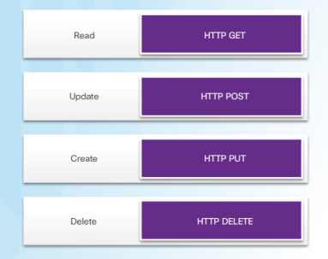
Create an IoT System 6.3.1 THE IoT System Project (cont’d)
REST API in an IoT System
REST APIs use HTTP methods to exchange data between systems or applications
RESTful systems use Uniform Resource Identifiers (URIs) to represent their services to external systems.
Sample URIs:
GET /people/michael to receive Michael's user profile dataset
POST /people/michael to update Michael's profile with new data.
The IFTTT web service allows for special resource URIs to be created and mapped to specific IFTTT actions.
Example IFTTT URI - https://maker.ifttt.com/trigger/SunRise/with/key/
The sunrise/sunset example uses both IFTTT and Google Calendar services
Notes:
6.3 – Create an IoT Solution
6.3.1 – The IoT System Project (cont’d)

Slide 15
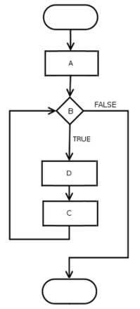

Create an IoT System 6.3.1 THE IoT System Project (cont’d)
Flowcharts, Electronic Schematics, and Sequence Diagrams
Documenting project is very important for building the devices, testing, troubleshooting, and creating a business model.
Flowcharts use standardized symbols to represent the processes and workflows.
Electronic schematics is a graphical representation of a circuit diagram using internationally standardized components.
Sequence diagrams represent interactions between entities along a timeline.
Notes:
6.3 – Create an IoT Solution
6.3.1 – The IoT System Project

Slide 16
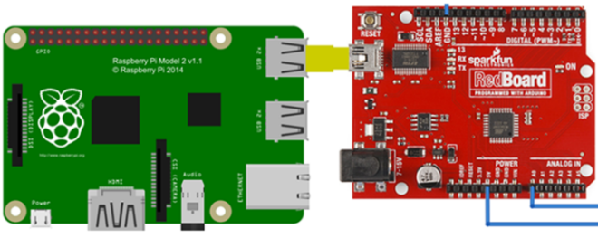
Create an IoT System 6.3.1 THE IoT System Project (cont’d)
The Code
The sunrise/sunset example is written in Python using a Raspberry Pi
The Arduino is connected to the Raspberry Pi.
The programming is done on the Raspberry Pi to send the level of voltage drop from the Arduino to the RaPi.
Firmata, a generic protocol for communicating with microcontrollers, is used to communicate between the Arduino firmware and the RaPi.
The Python code used for the sunrise/sunset example is explained line by line.
Notes:
6.3 – Create an IoT Solution
6.3.1 – The IoT System Project

Slide 17

Create an IoT System 6.3.2 THE IoT System Prototype
Overview of the Problem
Simple problem identified that can be solved by an IoT system: remote access to determine if garage door is open or closed
Switch can determine if a door is open or closed
Switch attaches to a controller – which keeps track of switch status
Controller connected to Internet to provide remote access
Prototyping and testing System
Create electronic schematic, flowchart, and sequence diagram for prototype
Packet Tracer 7 used to create and test the prototype.
Update documentation once prototype works successfully.
Documenting is important not only for future reference but also for situations where marketing material or patent applications are to be created.
Notes:
6.3 – Create an IoT Solution
6.3.2 – The IoT System Prototype

Slide 18
6.4 The Business Aspects

Slide 19
Business Model Canvas 6.4.1 Business Model Canvas
Business Model Canvas Overview
Helps organizations and entrepreneurs map, discuss, design, and invent new business models.
A business model consists of nine building blocks:
Customer Segments, Value Proposition, Channels, Customer Relationships, Revenue Stream, Key Resources, Key Activities, Key Partnerships and Cost Structure.
Customer Interface
Customer Interface is comprised by Customer Segments, Value Proposition, Channels, Customer Relationship.
Infrastructure Management
Defines how to build the value proposition.
Key Resources, Key Activities, and Key Partnerships make up the Infrastructure Management.
Notes:
6.4 – The Business Aspects
6.4.1 – Business Model Canvas

Slide 20
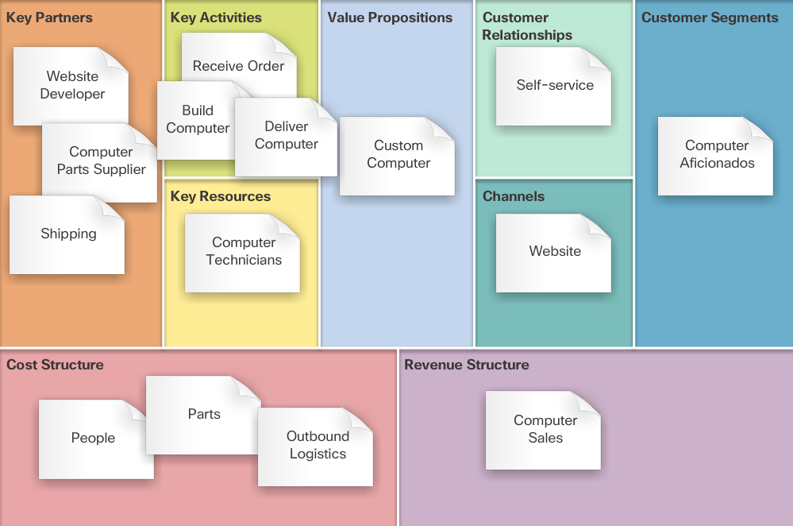
Business Model Canvas 6.4.1 Business Model Canvas (Cont.)
Business Finances
Include the cost structure and revenue streams created by the value proposition.
Business Model Canvas Example
Example of a completed business model canvas for a custom computer manufacturer.
Notes:
6.4 – The Business Aspects
6.4.1 – Business Model Canvas

Slide 21
6.5 What is Next?

Slide 22
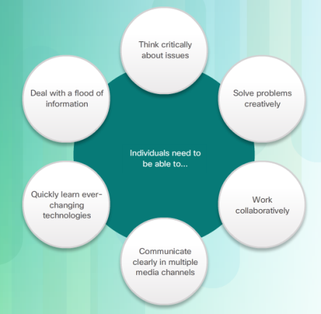
What is Next? 6.5.1 Lifelong Learning
21st Century Skills
21st century job market is now looking for employees who can accomplish one or more job roles such as: design a project, prototype a device, create and maintain documentation, and create a business plan.
IoT employees also need learning and innovation skills
Creativity and innovation
Critical thinking and problem solving
Communication
Collaboration
Notes:
5.4 – Become a Global Problem Solver
5.4.4 – Lifelong Learning

Slide 23

What is Next? 6.5.1 Lifelong Learning (cont’d)
Resources for Continued Learning
There are many resources available to enable you to continue learning about the IoT including:
Cisco Networking Academy
Cisco Learning Network
Cisco DevNet
IEEE Computer Society (IEEE-CS) and the Association for Computing Machinery (ACM)
Many other online resources including forums, wikis, blogs, and more
There are also IoT communities of practice consisting of other like-minded individuals who want to share ideas with others.
Notes:
6.5 – What is Next
6.5.1 – Lifelong Learning

Slide 24
6.6 Chapter Summary

Slide 25
Chapter Summary Summary
There are many global social and environmental problems that can be solved by IoT systems. The Institute for Globally Transformative Technologies (LIGTT) has compiled a list of 50 breakthrough technologies that will drastically improve the work on these global problems.
The Engineering Design Process is a proven method to develop a product.
The first step to design an IoT solution is to identify a problem that can be solved with an IoT device. To test the idea, a prototype could be built simply by using a Raspberry Pi with an attached Arduino. To provide an example, a sunrise/sunset tracker was built.
Another prototype was designed on Packet Tracer to remotely check to see if the garage door was open or closed..
Documentation is very important component of any project. Flowcharts, Electronic Schematics and sequence diagrams are often used to provide documentation.
The Business Model Canvas helps organizations and entrepreneurs map, discuss, design, and invent new business models based on a value proposition, customer interface, infrastructure management, and finances
IoT professionals should be individuals who espouse life-long learning. They need to be flexible, take the initiative, lead when necessary, and be able to produce something new and useful
Notes:
6.1.1 - Summary

Slide 26


Slide 27


